Slide 1
Mental set
8 x 7=
A triangle with a base of 5cm and a height of 8cm?
Area=
Perimeter=
A Rectangle with a Length of 10 cm and a width of 12cm?
Area=
Perimeter=
f + f + f + f + d + d + g – f =
2 + 9 x 4 – 15 =
(2 x 7) – (3 x 3) + 6 =
Notes:
hook

Slide 2
Last lesson Review
Create a list ratios that are equivalent to:
9 : 12
18 : 24
Notes:
Check for understanding

Slide 3
Lesson objective
By the end of this lesson you will be able to;
- Simplify ratios and further your understanding of equivalent ratios.
Notes:
Lesson

Slide 4
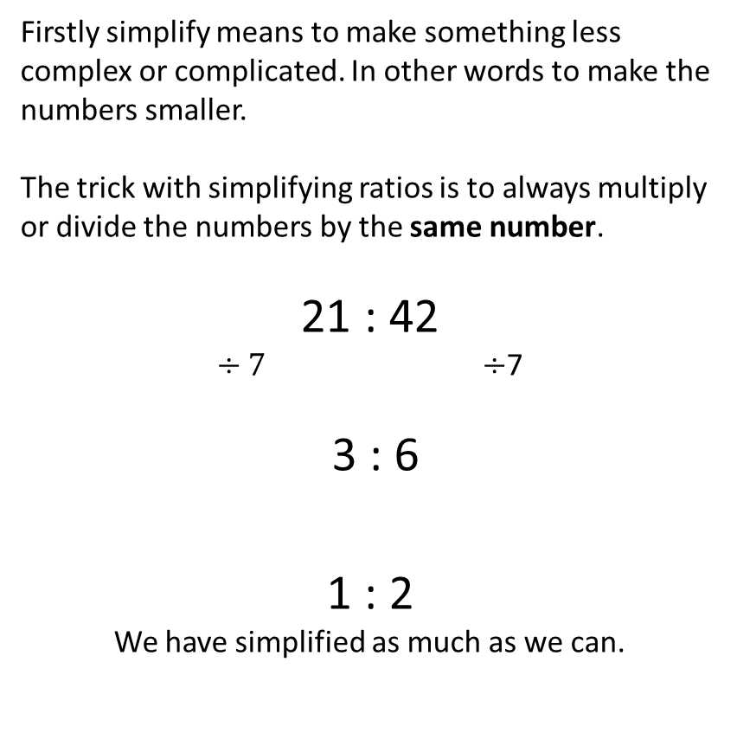

24
7
30
Date
Title – Simplifying Ratios
EQ: How do you simplify ratios?
Firstly simplify means to make something less complex or complicated. In other words to make the numbers smaller.
The trick with simplifying ratios is to always multiply or divide the numbers by the same number.
21 : 42
$÷7 ÷$7
3 : 6
1 : 2
We have simplified as much as we can.
What does simplifying ratios look like?
$$÷3 ÷3$$
5
Notes:
Lesson objective (EQ)

Slide 5
Guided Practice
Simplify the following ratios? You may need to simplify several times.
48 : 12
63 : 27
16m : 40m
600k : 1800k
7.2 : 3.6
Notes:
Guided practice

Slide 6
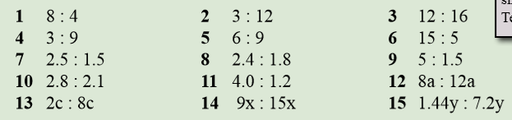
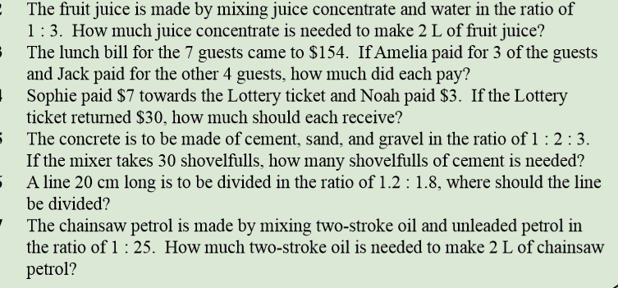
Activity
Notes:
Independent practice

Slide 7
Closure activity
Exit pass – What is the following ratio fully simplified?
35 : 70
Notes:
Closure

